Slide 1
how to use SOLID in full stack development
What is SOLID principles and how we can use them in project engineering of web pages.

Slide 2
SOLID introduction (IMHO)
SOLID is always welcome, it is not an pattern it is principle. And should be treated like principle.
using SOLID is not about following rules, it more about engineering planning.
not all code followed by all rules will be better, rules should be reviewed and used only when they give profit.
almost any code can be reworked to SOLID, it just should be done step by step.

Slide 3
what is SOLID overview
S = Single Responsibility
O = Open-Closed principles (code shouldn’t be edited)
L = Liskov Substitution Principle (crete reusable method results)
I - Interface Segregation Principle
D - Dependency Inversion Principle

Slide 4
SOLID goals
make code simplier
make code reusable
make code flexible
make code structurated
make code more readable
make code improvable

Slide 5
Presentation goals
explain how to implement SOLID features
when implement SOLID features
give more understanding in SOLID practical examples.
visalisating results.
explain code refactoring choices

Slide 6
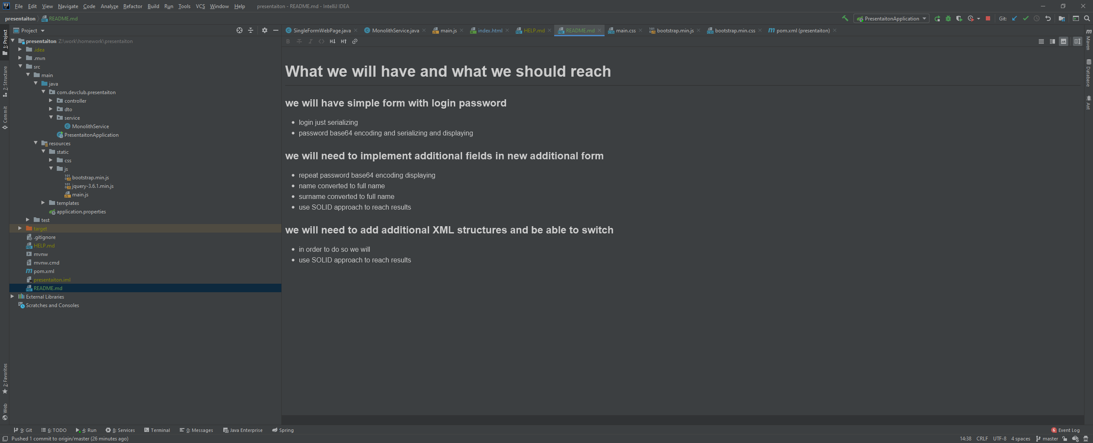

Slide 7
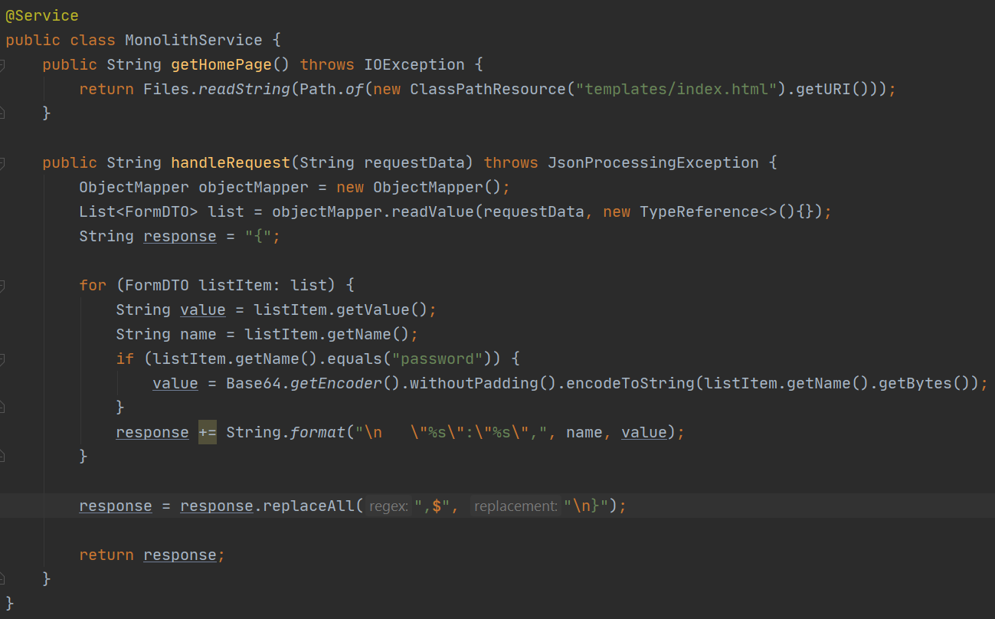
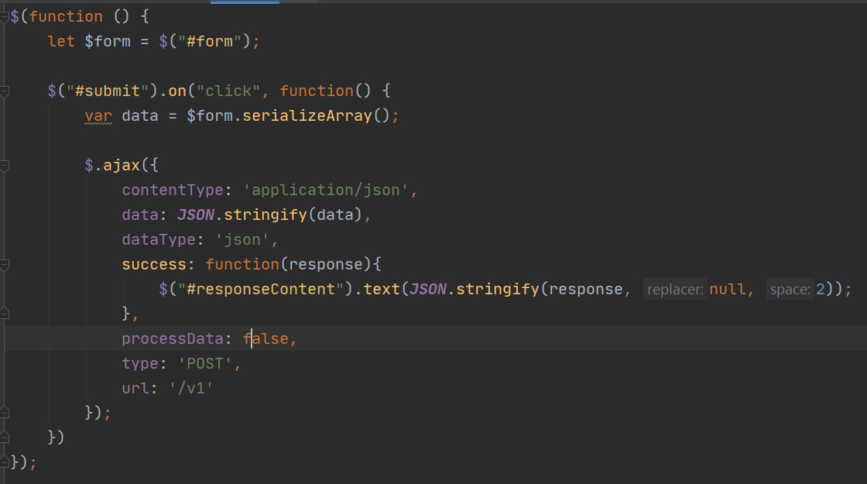
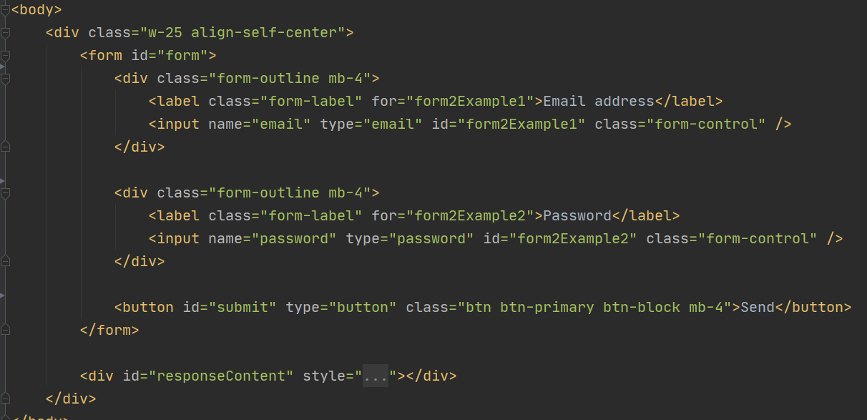
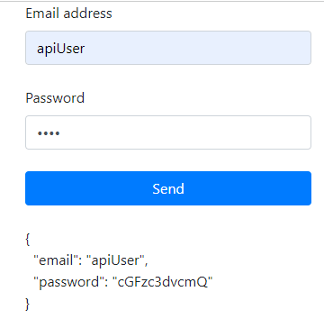

Slide 8
next step goals
now we have simple application that is working
in order to reach flexibility and implement multiple forms we need to make code SOLID before we continue let’s repeat goals
our goals is to make multiple forms with multiple data handling
one is Let’s name it «Login form» that we have already
second will be let’s name it «Register form » that we need to implement additionally.
in order to do so we need to analyze existing code, for splitting it in logical reusable segments.

Slide 9

analyze HTML
we should find dynamic elements (form inputs) and split them to separated file
in order to reuse them
single reusable element for input will look like next image

Slide 10
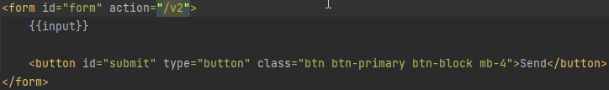
next we should prepare html body
in order to apply new elements, we should add place where we will generate them
please notice that we used Twig variable snippets like {{input}} for implementing dynamic elements.

Slide 11

implement form navigation
we need to implement 2 forms with switch between them, so we need add new additional element (buttons for switch)
nav item will be form listing item
action will lead to current form target to understend where nav item is submitting results

Slide 12
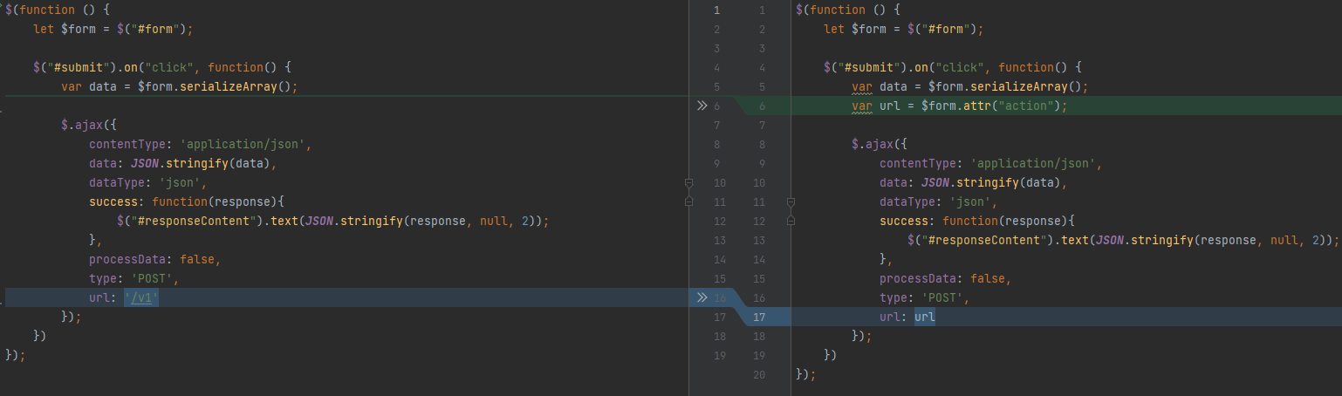
now we should adjust js code for dynamic

Slide 13

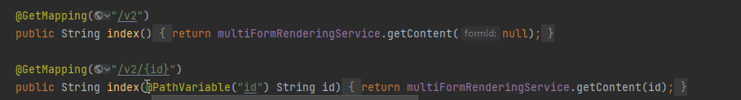
now when we prepared FE we continue to BE
we need to review first step in our code that is controller
we need to implement preview with dynamic link
into next actions

Slide 14
now let’s continue with service method
we have single file read we should adjust it into new format with partial file filling
so now we need this file to take new partial html and rework logic to solid in order to replace new parameters.

Slide 15
related info
to do so we need to remember than we have 2 templates types visible right now 1 is primary template content and second is input template content.
we have 2 abstraction levels so same we will need SOLID interface levels

Slide 16
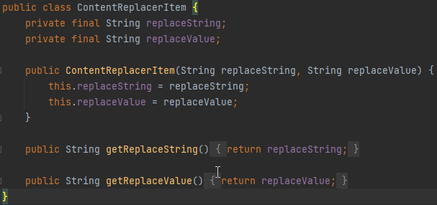
value content replacer
we need a container that will store data what we replace. for example, we need {{label}} >> Email address
so, we need container to store data what we will replace on what.
I didn’t use interfaces as I didn’t need it here, as I plan to have simple values

Slide 17

collections of repalcing values
as we remember we have multiple items in single html file so we should have more than 1 container for single replacement.
so next we will create Interface for those items

Slide 18
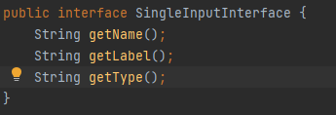
next we can create some abstraction for input
as we see we can count how much fields we will need in html and may create class
now when we have clear picture what and how we need. Must forward to next automatic generating item link.

Slide 19


link SOLIDify actions.
first we create html template.
next we create interface. with replacing values
now when we have Input item and nav item we can start thinking how to unite them under one Interface. in order to get collection of replacing items.

Slide 20
next important step is decide
currently we have input and link implementations
in order to unite them we need we need to find how we can rework them to collection.
in order to do so we will need additional interface. that will give this collection and implement in both items

Slide 21


question why separated interface ?
first, why we need separated interface ?
first answer is to reduce repeat logic we have
first option create abstraction class (this is not SOLID approach)
second create Interface and Handler for separation of each item getting of one interface another.
so, let’s move on.
here we have created one and let’s move to handler

Slide 22
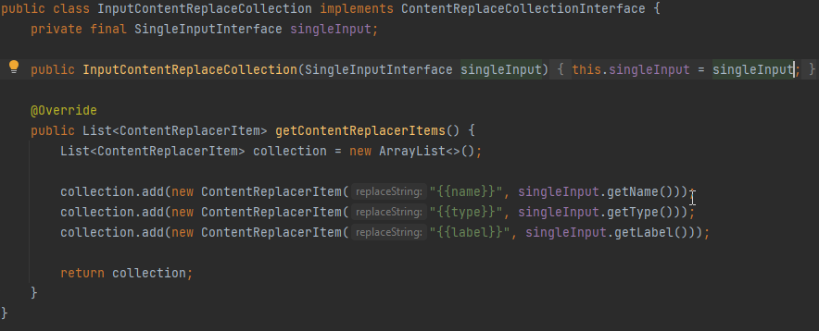
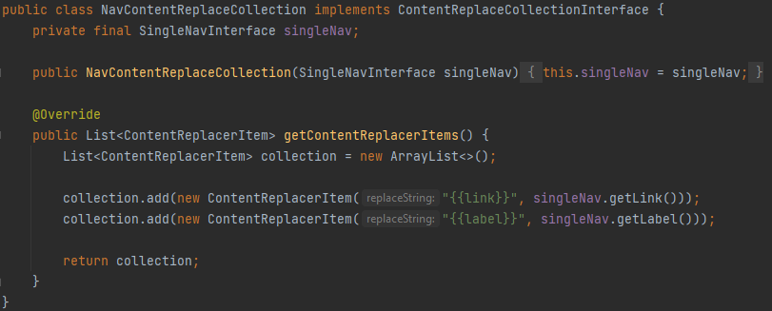
one for input
one for nav item

Slide 23
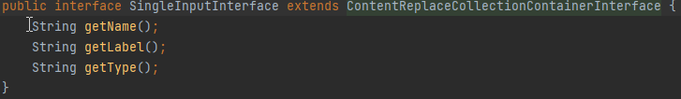
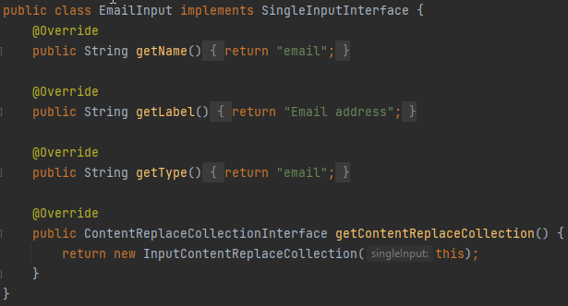
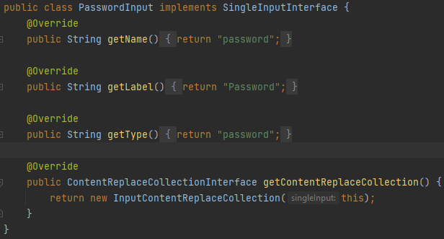
now we can create first inputs email and password

Slide 24


next we will need to create form
first, we should understand what form will have
first thing is one form contains multiple inputs so, it’s and input collection.
let’s create interface

Slide 25
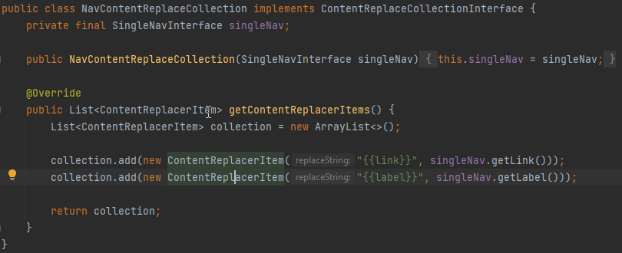
same as with input we need converter to valid SOLID collection.

Slide 26
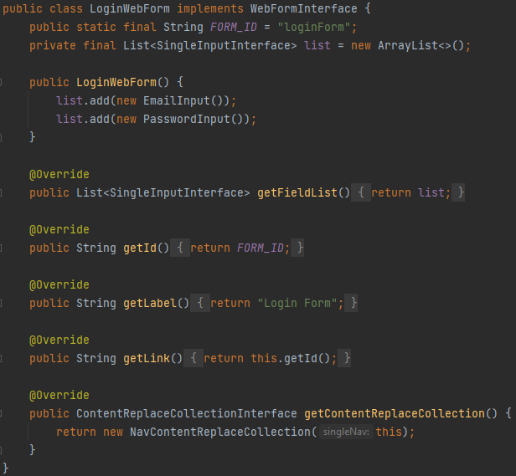
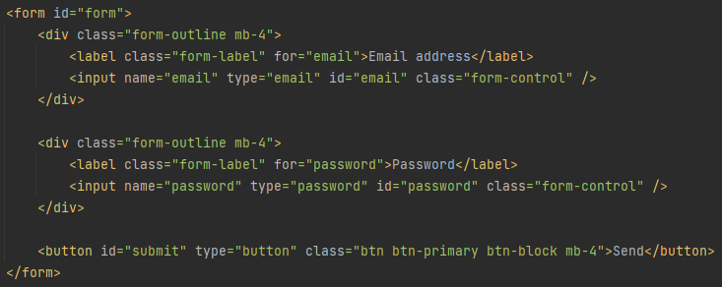
now we have everything to create “Login form” object

Slide 27

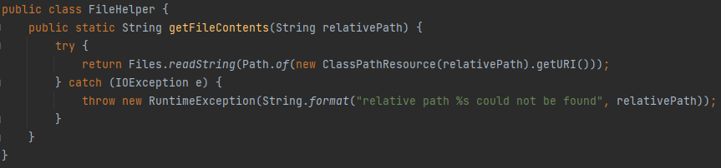
when theory is prepared move to practice
let’s analyze our method and rework to SOLID approach.
now we have multiple html files
reworked into >
so now we need file helper to reduce repeat code.

Slide 28
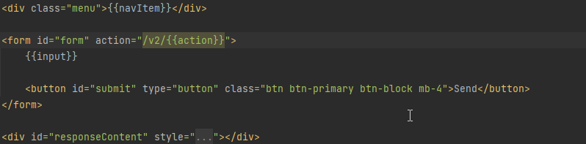



now let’s move forward to service and start creating its structure.
so now we need some interface to replace {{…}} in content
then we need html content for replacing
also, we have multiple inputs and nav items, so we need some collection for replacement

Slide 29
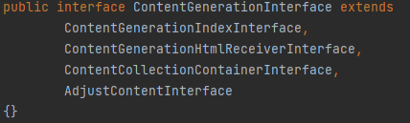

we need additional interface for content update.
please notice how we split interfaces

Slide 30
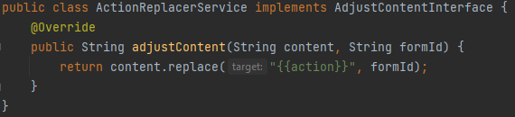
first will be action content adjuster.
as it doesn’t require complex logic and will be easy to understand.
this will prepare proper action for our form submitting to detect which form is submitted.

Slide 31
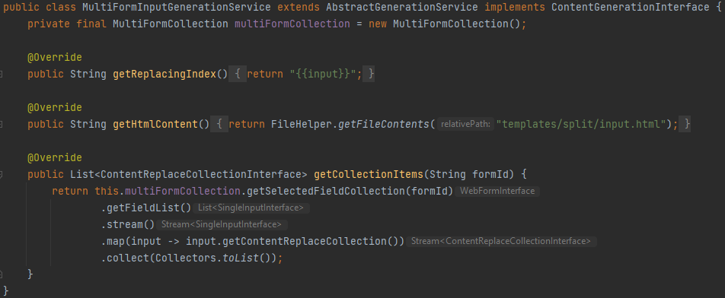
now I think we are prepared to move from planning to creating logic.
and create first service for input generation
as logic of content replacing will be common for all services, I moved it to abstraction. analyze next slide.
explain stream collect

Slide 32
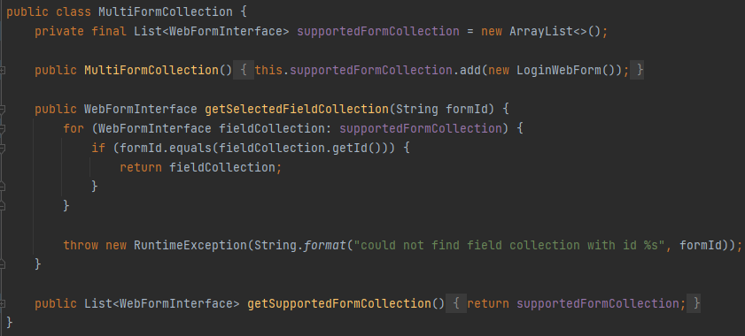
multi form collection looks something like
it is not interfaced as we don’t need multiple “Multi Form Collections”, so we don’t need to implement SOLID principle here.

Slide 33
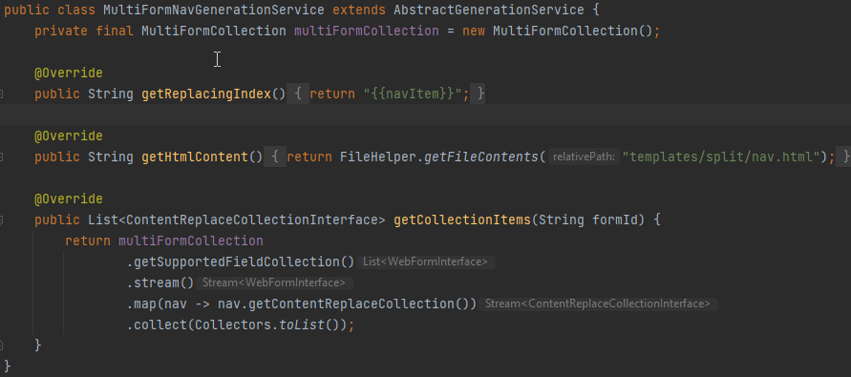
now multi nav item generation service.
we create {{input}} and {{navItem}} item but first let's look into adjustContent method.

Slide 34
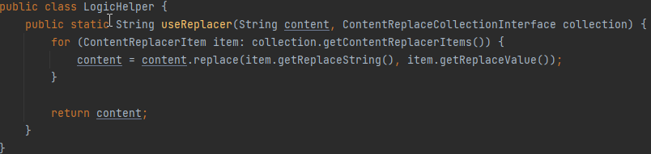
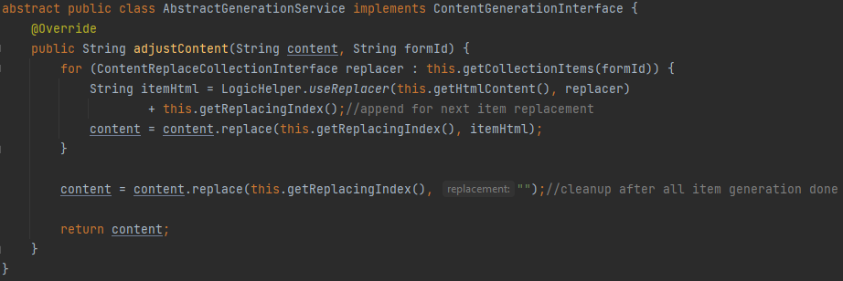
now we need to create common action for replacing multiple items, by previously shown data. I will show 2 complex methods.
logic helper to replace items by interface.
we need to prepare next content adjuster for html files.

Slide 35
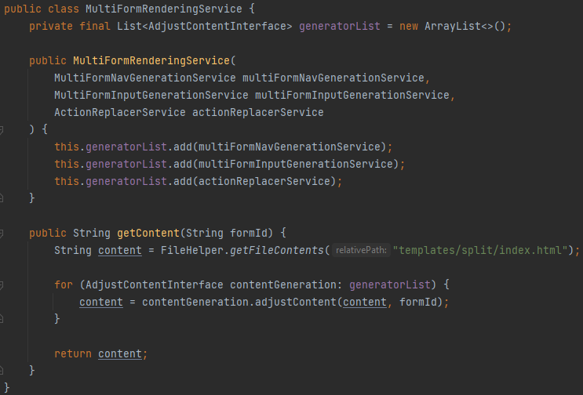
now we can create rendering service to render full output.

Slide 36
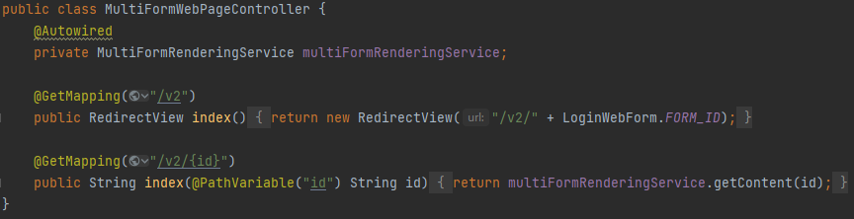
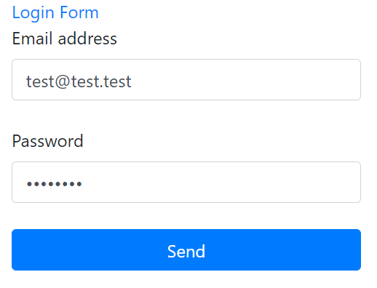
so next steps is to make controllers and watch what we will have in the end.

Slide 37
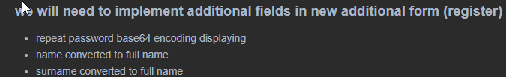
good SOLID environment is created for html generation
now we can choose what to do next
implement second form (Registration form) or implement solid form submitting logic.
I will show how we can add new form in order to show how easy it is to use solid environment.
so, lets find next steps.
create input objects for new 3 fields

Slide 38
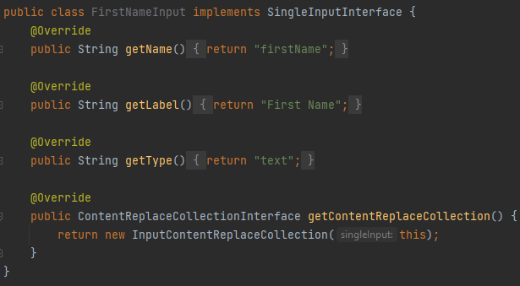
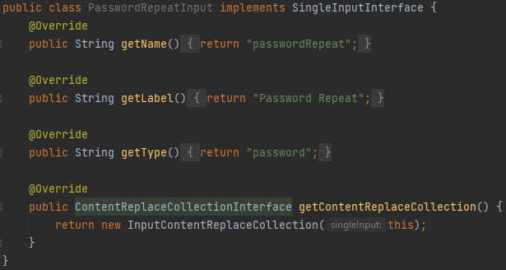
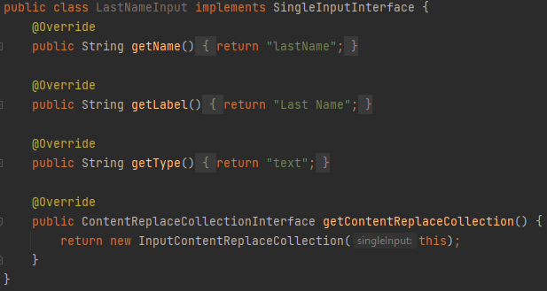

Slide 39
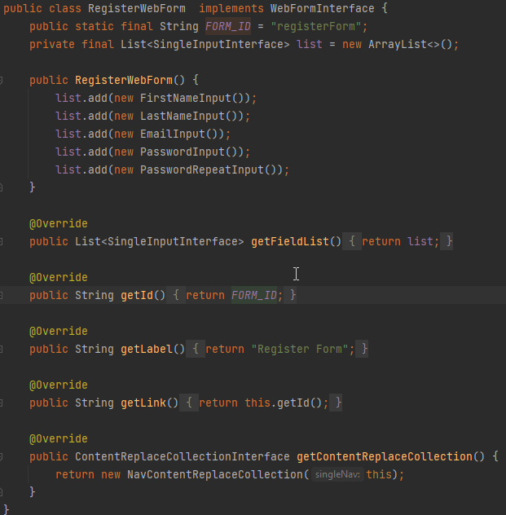
so now we have everything to create new form
if you noticed getLink() method
returns result of getId().
you may ask why ?
just to keep good value naming
with same values as id, we use for
getting item from collection list
and pass as link into action.

Slide 40
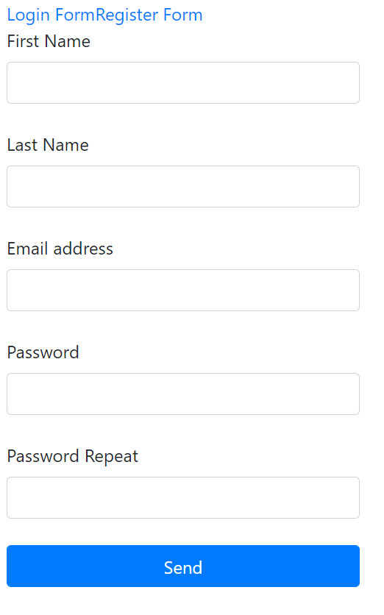
now let’s look what we have in the end.
after we made form with selection option
we need some improvement
add navigation signs
where we are and make better
readability of link items
to save some time I will use FE here

Slide 41
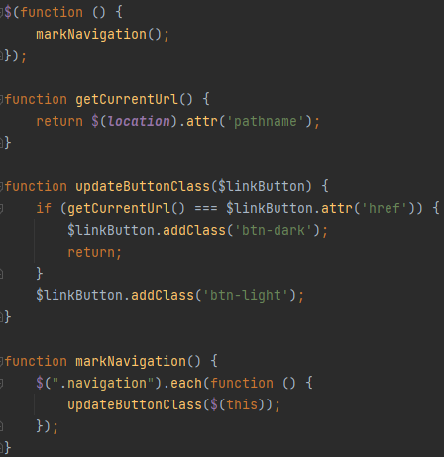
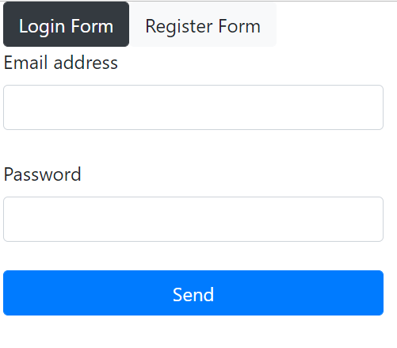
we update html to add styling
and add next JS lines and add call to
it’s not SOLID as JS can’t support SOLID but I tried to use S (Single responsibility) here.

Slide 42
now we need to implement logic
currently we implemented visual part, but we have also logical so we will need to create action for preparing data according to requirements.
first we need to analyze existing source code and split it into a parts.

Slide 43
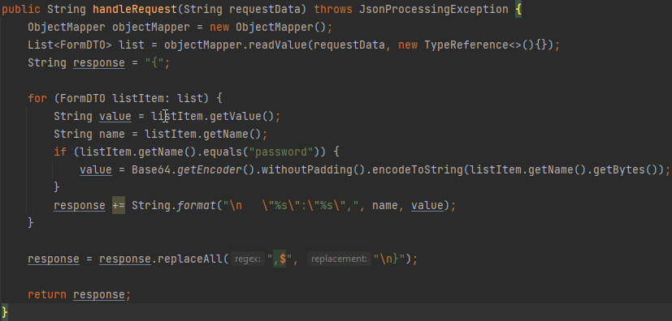
I can split this code to 3 parts
serializing logic.
listing items
and handling each item separately

Slide 44
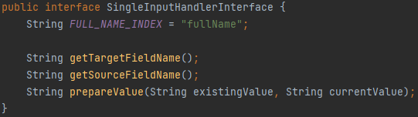
lest begin with data interfaces
we need to unite 2 fields into one, so we need to rename them, and we need target field
also, we need to prepare values for response
I created constant to unite 2 fields into single editing name as interface constant.

Slide 45
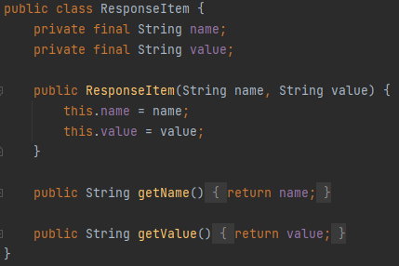

as I mentioned previously, we need Response object
why we need it ?
to explain serializer response items
now we can create serializer interface
as we have everything to explain the output and input data.

Slide 46
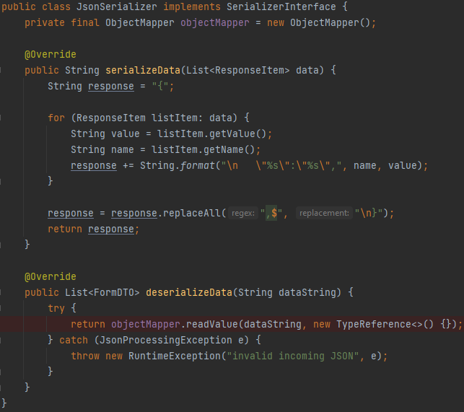
if we have interface, we need to create an object. for this interface
is this fully SOLID ?

Slide 47
if we have interface, we need to create an object. for this interface
is this fully SOLID ? – NO
reason to be solid we should
split SerializerInterface and
extend from 2 different.
as we can reduce method
requirements to 1 method only.

Slide 48
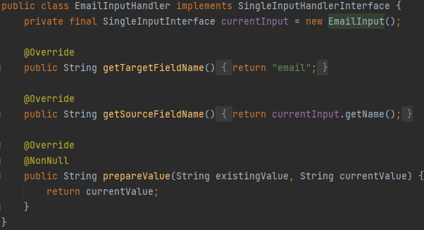
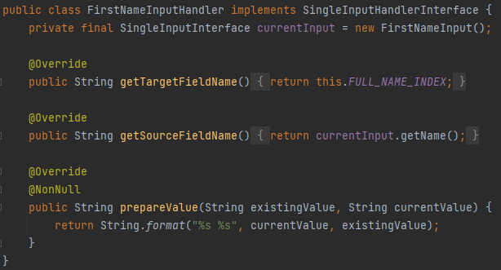
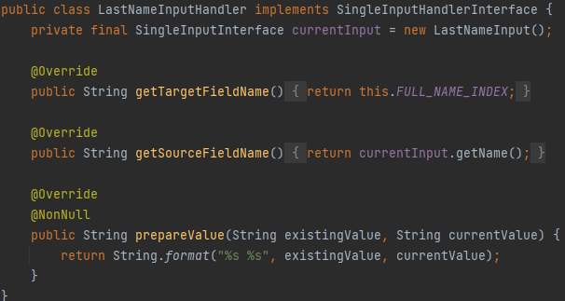
also, should create handler for each input

Slide 49
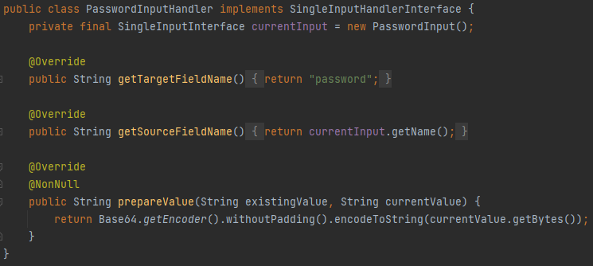
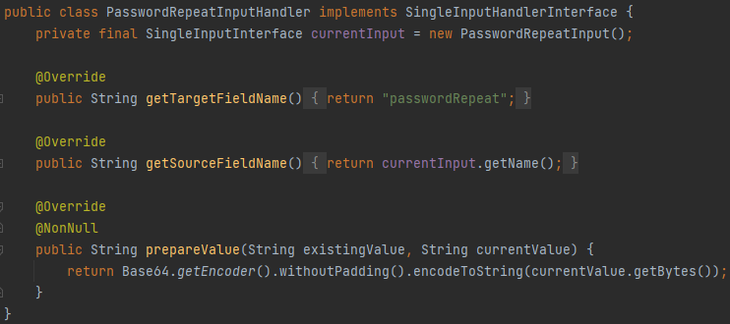
and password fields

Slide 50
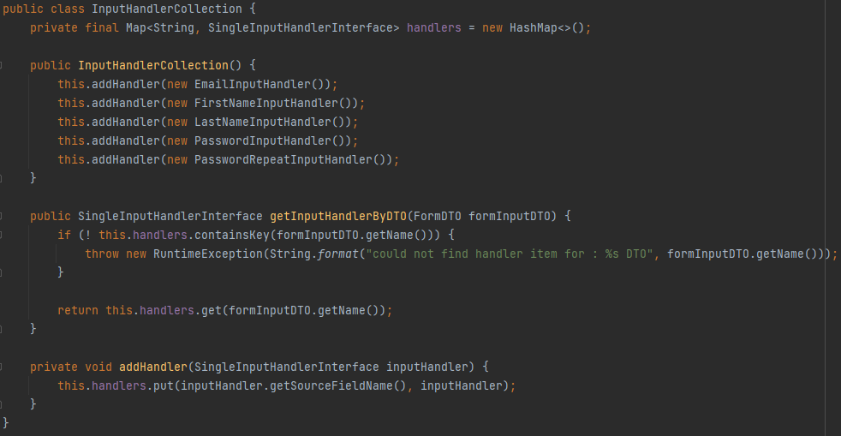
and also collection for them

Slide 51
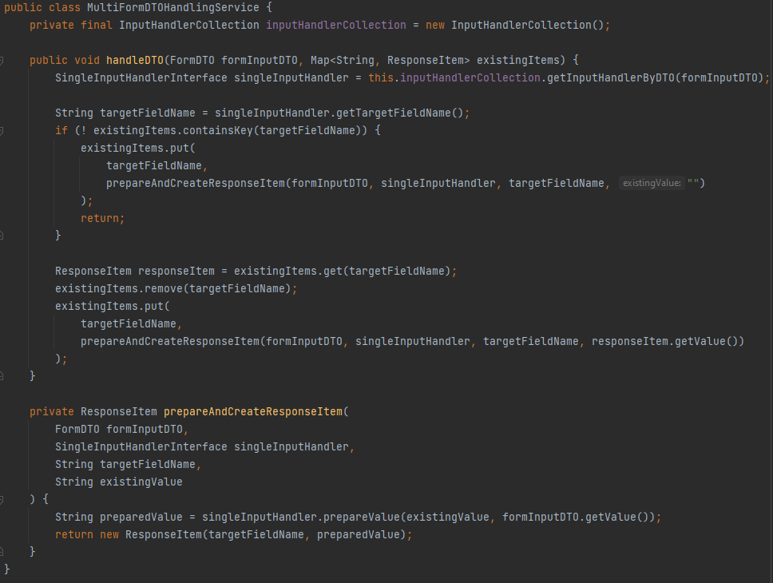
so now we will create service for converting single DTO into response item
notice it I didn’t make
it SOLID.
I don’t see reasons
as we doesn’t need
multiple services.

Slide 52




also, I wanted to add validation to handle only form inputs to make it more stable and predictable.
it may be treated as SOLID even if we implement it in existing service.
but we should understand tha WebFormInterface doesn’t match Interface segregation
to be fully SOLID we should split getFieldList() into separated Interface. and mark it instead of WebFormInterface as Param type
here is example

Slide 53
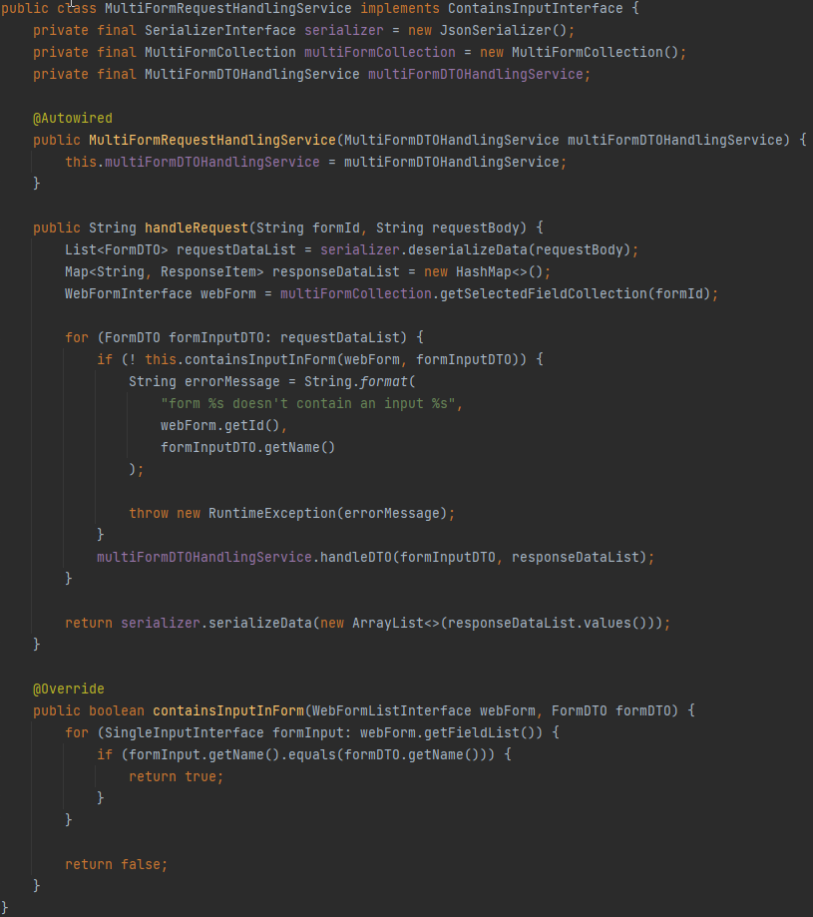
now even if we implement it in existing service, it will be SOLID
and again, we don’t need to SOLID here, as we don’t need it.
we will reach our target, so no need to stick to it without reason
we have partially SOLID class
and containsInputInForm I created just to show. that SOLID parts can be implemented in not SOLID services and it won’t be a violation.

Slide 54



and finally, all we should do is make new action.
and we can see the results.
also, we can add validations
additional encodings like XML within 20-30 minutes
and all thanks to following SOLID principles where we need them in order to make project flexible. you may try it yourself.
time for presentation is limited so I will stop here.
hope it will be useful for you.
all code and presentation is uploaded to my public github account so feel free to use it.

Slide 55
Thank you for your attention! sources:
Bootstrap (UI styling)
https://getbootstrap.com/docs/4.0/getting-started/introduction
JQuery (Simple multi-browser support)
https://jquery.com/
self made sources github
https://github.com/Neznajki/devclub_example
what is solid
https://www.digitalocean.com/community/conceptual_articles/s-o-l-i-d-the-first-five-principles-of-object-oriented-design

